Slide 1

Customer Care ABC
Presented by: Igor Kocic
Last updated: November 6th , 2022

Slide 2
Customer Care Call Centre Project -1st part
1.1 Present intra-week evolution by segment & global
1.2 Calculate weekly percentage of answered calls and percentage of answered calls before 30 seconds by segment and global. Define a target for KPI and show achievement vs. that target.
1.3 Show the weekly Average Handling Time (AHT) for each segment expressed in number of seconds (target is set as 320 seconds)
1.4 Present other relevant information that should be presented

Slide 3
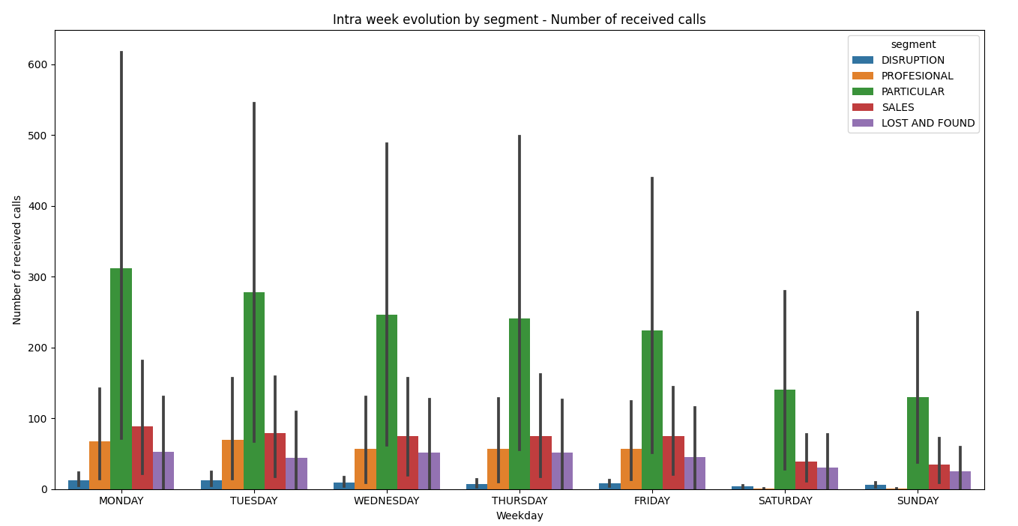
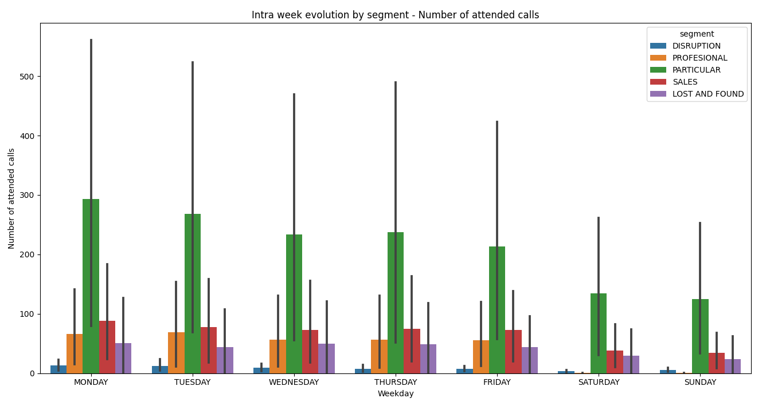
1.1 Intra-week evolution by segment & global
Number of received calls and number of attended calls by segment

Slide 4
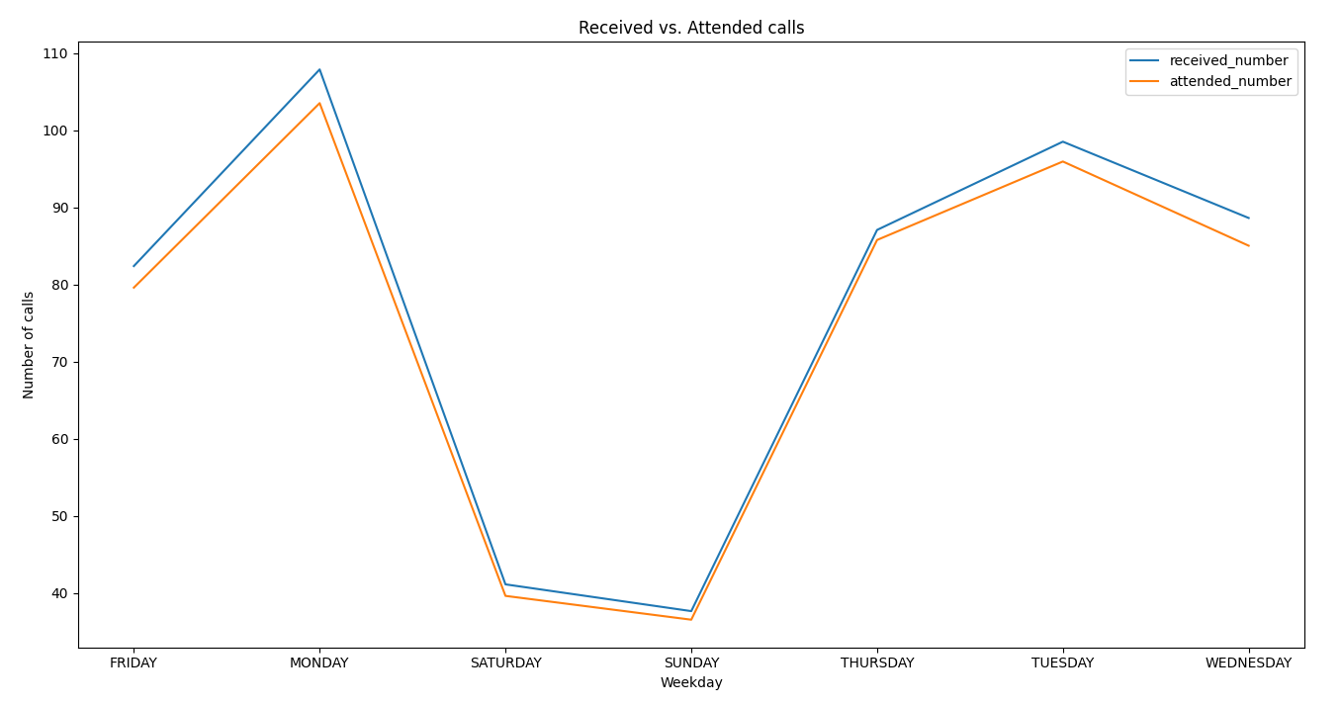

1.1 Intra-week evolution by segment & global

Slide 5
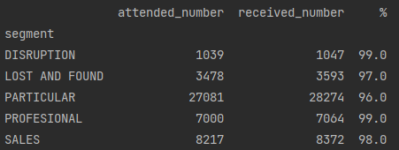
1.2 Calculate weekly percentage of answered calls by segment and global
Global weekly percentage of answered calls is 96.83%

Slide 6
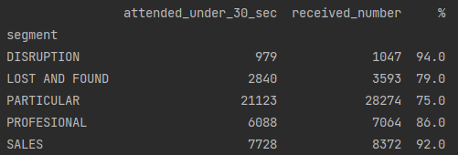
1.2 Percentage of answered calls before 30 seconds by segment and global
Global weekly percentage of answered calls under 30 seconds of waiting is 80.16%
Further analysis needed to discover why lost and found and particular segments have
lower percentage of answered calls under 30 seconds than other segments.

Slide 7
1.2 Defining a target for the KPI and showing achievement vs. that target.
A common service level target is for an agent to answer 80% of calls within 30 seconds (80/30).
This is an effective KPI to ensure that a call center has proper staffing for inbound phone lines
and that the wait time to answer customer calls is at an acceptable level.
Since our global percentage of answered calls under 30 seconds is slightly over 80%
we can conclude that GLOBAL TARGET is ACHIEVED.

Slide 8
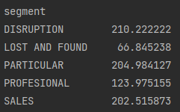
1.3 Weekly Average Handling Time (AHT) for each segment expressed in number of seconds
(target is set as 320 seconds)
Target is achieved since average handling time for each segment is below 320 seconds

Slide 9
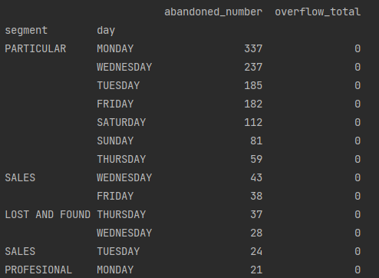
1.4 Other relevant information that should be considered
Further analysis needed to discover why there are deviations on certain day and in certain segments.
Especially in particular segment where we have extreme values for every day of the week.

Slide 10
Customer Care Call Centre Project -2nd part
Our financial model with the external supplier is based on answered calls. Call center operations are based in USA and Canada. Approximately, 55% of calls are managed in USA except S3 segment that is managed in the USA at 70%. Regarding S3, 80% of the calls are purely Sales while the other 20% are Loyalty driven. If the prices are the ones attached:
2.1 Estimate the monthly cost of the service

Slide 11
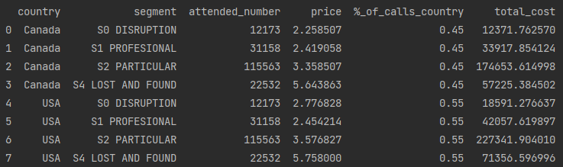
2.1 Estimate monthly cost of the service by segments (except S3) and countries
Monthly costs for S2 Particular segment (for both countries) is significantly higher
than monthly costs of other segments
Estimated total monthly cost for S0, S1, S2, and S4 segments and all countries is 637,516.01 €

Slide 12
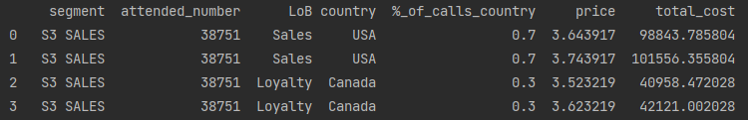
2.1 Estimate monthly cost of the service for S3 segment by countries
Estimated total monthly cost for S3 Sales segment for both countries is 283,479.62 €

Slide 13
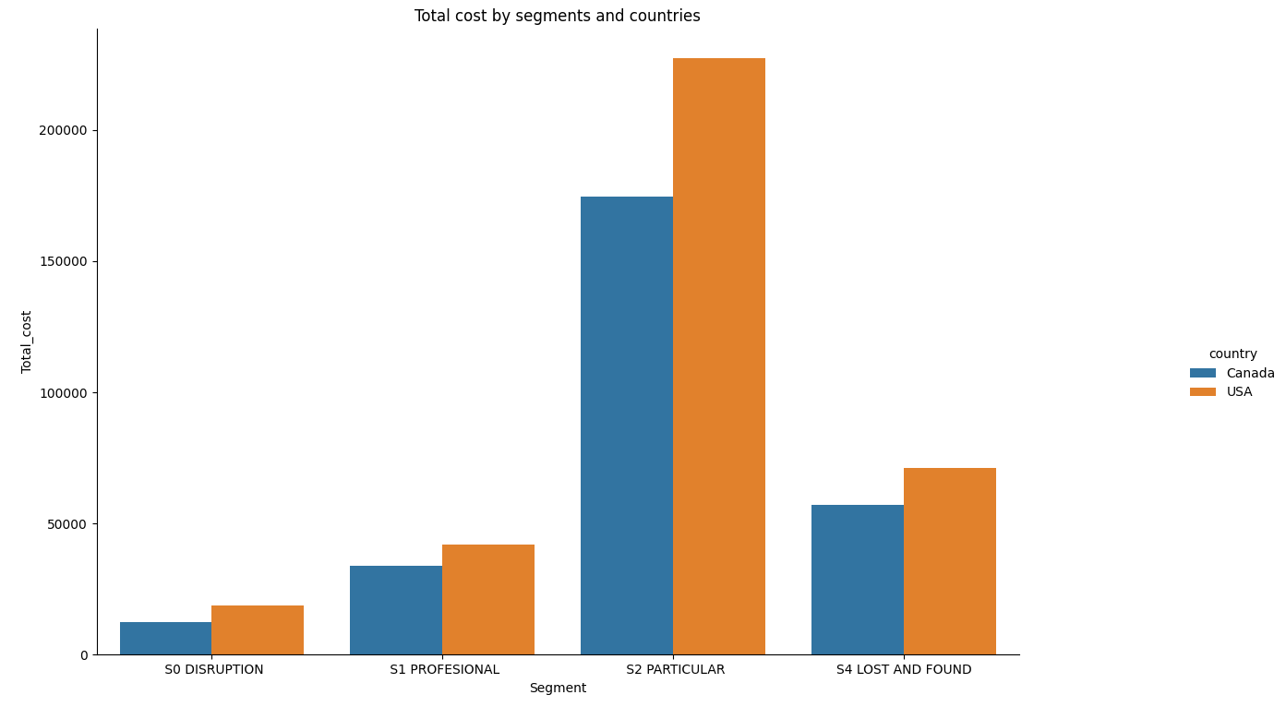
Estimated grand total monthly cost of the service for
all segments and countries is 920,995.63 €

Slide 14
References:
Service level KPI
https://www.techtarget.com/searchcustomerexperience/tip/8-customer-service-metrics-to-measure-call-center-success

